Slide 1
NEXTHIKES IT SOLUTIONS
Project 2: Data Acquisition and Data Wrangling
~Hasan Ahmed Khan

Slide 2
Tasks : Pre process the data sets and perform data visualisations
Perform data acquisition and data wrangling on a set of datasets. The datasets have many ambiguities. Merge the given datasets, identify ambiguities and apply different data-wrangling techniques to get a dataset for further usage and perform data visualization on final cleaned dataset.

Slide 3
01
STEPS INVOLVED
02
03
04
LOADING AND ANALYSING DATASETS
Displaying the datasets and dataset information
PREPROCESSISNG AND CLEANING THE DATASETS
Perform tasks like handling null values, fixing data types, check for duplicate values & data inconsistency
MERGING THE DATASETS
Join the datasets based on a common column
PERFORM EDA AND DATA VISUALISATIONS
Generate heatmap, bargraphs & other plots

Slide 4
01
LOADING AND ANALYSING DATASETS
Displaying the datasets and dataset information.

Slide 5
LOADING AND ANALYSING DATASETS
Import all the required libraries
import pandas as pd
import numpy as np
import matplotlib.pyplot as plt
import seaborn as sns
Load the datasets using .read_csv(path)
df1 = pd.read_csv('dataset_1.csv’)
df2 = pd.read_csv('dataset_2.csv’)
df3 = pd.read_csv('dataset_3.csv’)
df_a = pd.read_csv('dataset_a.csv’)
df_b = pd.read_csv('dataset_b.csv')
Display dataset and info using
.head()
.tail()
.info()
.describe()
Check for data inconsistency, null values, duplicate values etc.

Slide 6
02
PREPROCESSISNG AND CLEANING THE DATASETS
Perform tasks like handling null values, fixing data types, check for duplicate values & data inconsistency

Slide 7
HANDLING NULL VALUES
CHECK IF THE DATA TYPES ARE ACCURATE
DELETE DUPLICATE VALUES
Check for null values using .isnull().sum()
If null values found, fill with mean or median
Use .dtypes function to list datatypes. Change the data type if needed.
In dataset_1 and dataset_3 date column is saved as object.
Use .to_datetime() function to change datatype to datetime
Use .duplicated() to find if any duplicate values are present

Slide 8
DROP UNNECESSARY COLUMNS
CHECK FOR DATA INCONSISTENCIES
dataset_2 has an extra index column called Unnamed: 0 which can be deleted.
Use del function to delete extra column
Perform other data wrangling techniques and ensuring data integrity by verifying unique values

Slide 9
03
MERGING THE DATASETS
03
Join the datasets based on a common column

Slide 10
USE .merge() AND .concat() FUNCTIONS TO JOIN DATASETS
dataset_1 + dataset_2
dataset_a + dataset_3
dataset_b
Use df_a = pd.merge(df1, df2, on='instant’) to merge dataset_1 and dataset_2 and save it in new csv file called dataset_a.csv
df_a.to_csv('dataset_a.csv', index=False)
Use df_b = pd.concat([df_a, df3], ignore_index=True) to merge dataset_a and dataset_3 and save it in new csv file called dataset_b.csv
After performing all EDA on final dataset_b save it as a csv using
df_b.to_csv('dataset_b.csv', index=False)

Slide 11
04
PERFORM EDA AND DATA VISUALISATIONS
Generate heatmap, correlation matrix, bargraphs & other plots for final dataset_b

Slide 12
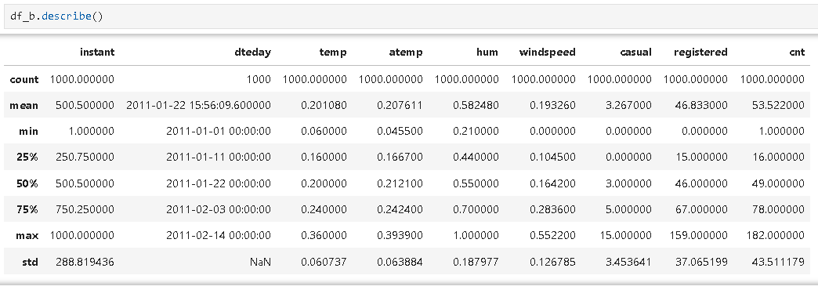
FINAL CLEANED DATASET

Slide 13
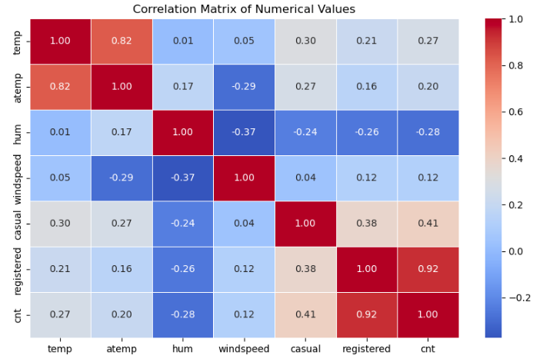
HEATMAP OF CORRELATION MATRIX

Slide 14
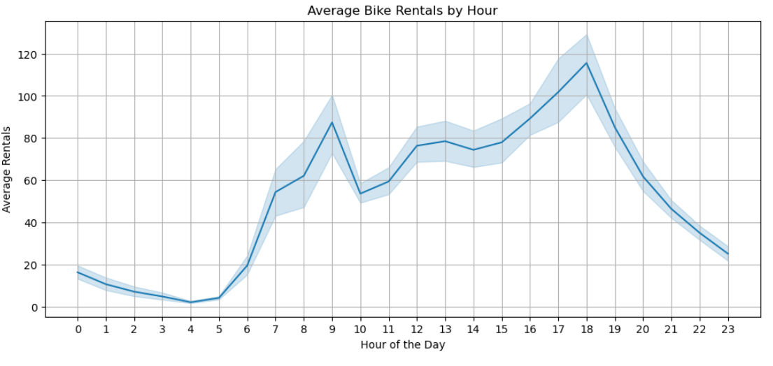
AVERAGE BIKE RENTALS BY HOUR

Slide 15
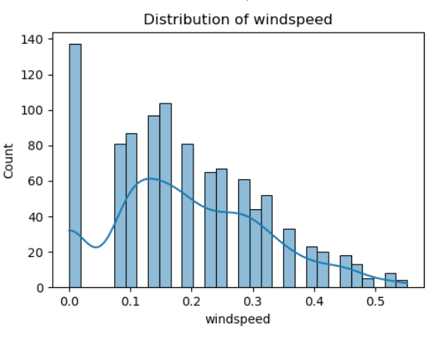
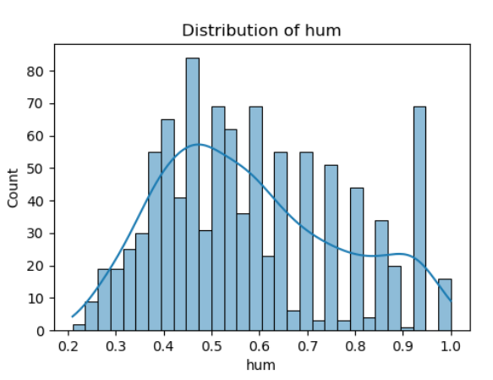
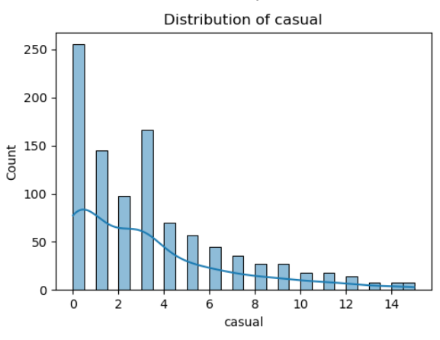
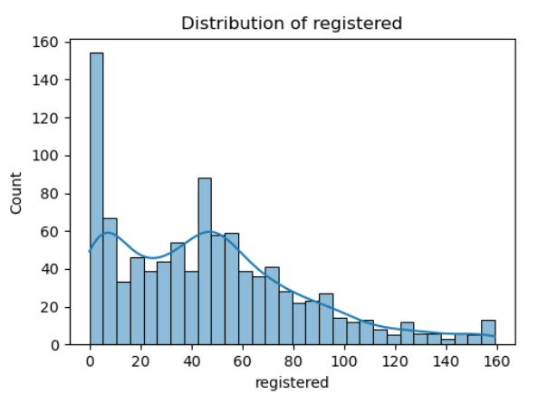
HISTPLOTS
DISTRIBUTION OF WINDSPEED
DISTRIBUTION OF HUM
DISTRIBUTION OF CASUAL
DISTRIBUTION OF REGISTERED

Slide 16
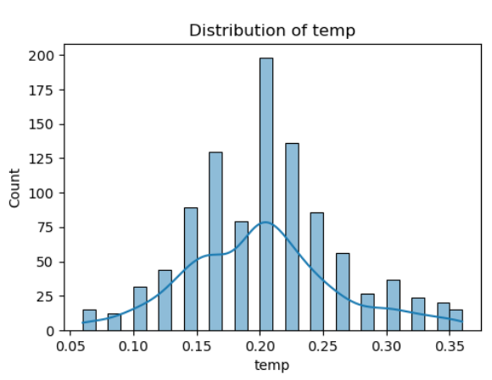
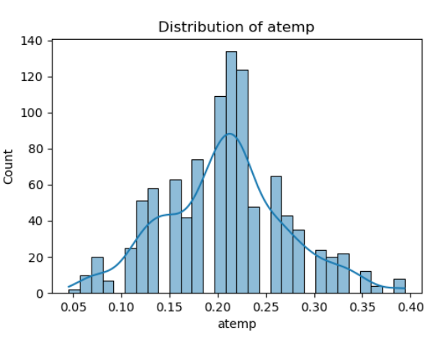
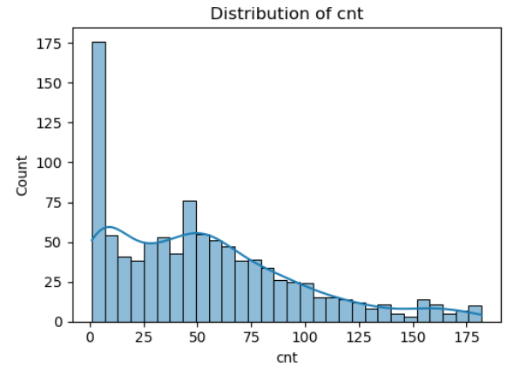
HISTPLOTS
DISTRIBUTION OF TEMP
DISTRIBUTION OF ATEMP
DISTRIBUTION OF CNT

Slide 17
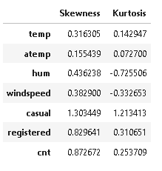
SKEWNESS AND KURTOSIS

Slide 18
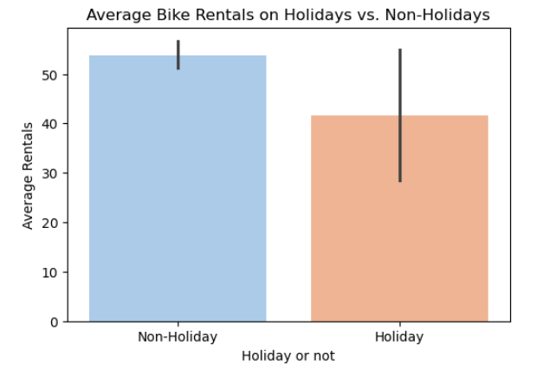
BIKE RENTALS FOR HOLIDAYS VS NON HOLIDAYS

Slide 19
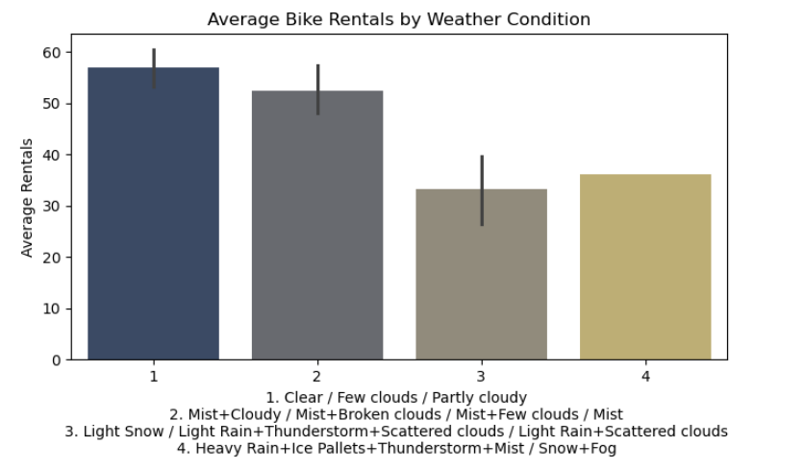
AVERAGE BIKE RENTALS BY WEATHER CONDITIONS

Slide 20
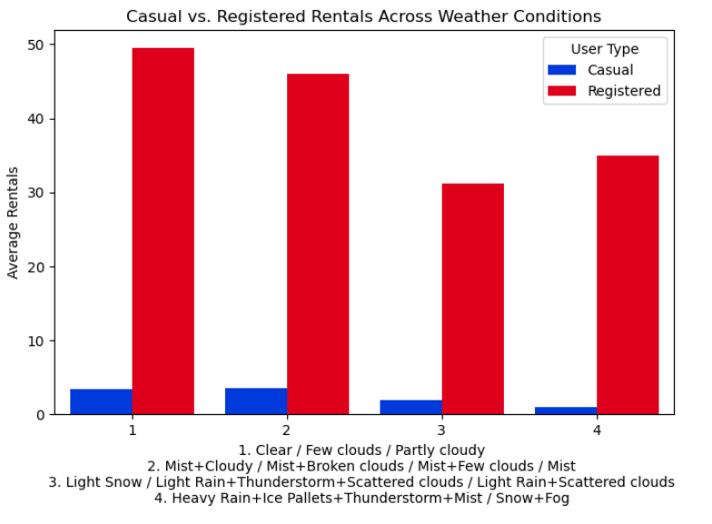
USER TYPES ACROSS DIFFERENT WEATHER CONDITIONS

Slide 21
THANKS!

